Slide 1
Privacy Preserving Neural Networks
Shreya Garge

Slide 2
Aim and Motivation

Slide 3
Aim and Motivation
Motivation : Privacy concerns raised by increasing prevalence of ML.
ML applications are vulnerable to :
Data theft.
Data Manipulation.
Model theft.
Compromises the privacy of the individuals represented in the data sets used.
Research towards privacy and security in ML has started very recently.

Slide 4
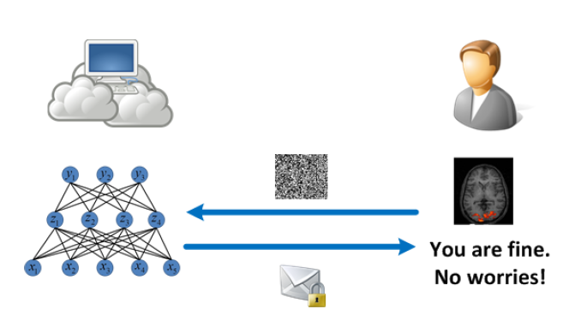
Aim and Motivation
Aim : Enable privacy friendly MLAAS.
Study, design and implementation of applying Neural network on encrypted data.

Slide 5
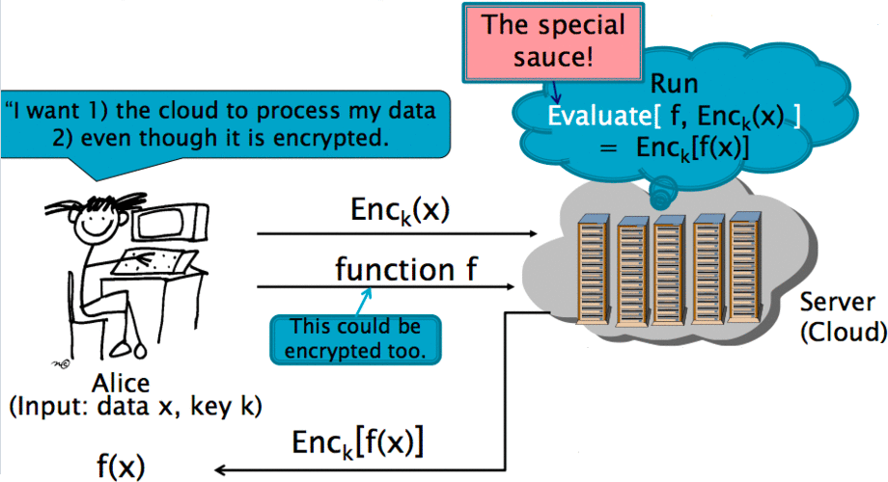
The Prediction Model
Encrypted data doesn’t ‘look’ like the data the model was trained on.
Server cannot decrypt to work on the data that makes sense to it.
Thus, the special sauce - Homomorphic encryption.

Slide 6
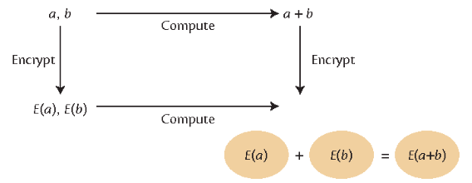
Homomorphic Encryption
An encryption scheme is said to be homomorphic if mathematical operations can be applied directly to the cipher texts, preserving the operation.
Dec(f(Enc(a),Enc(b))) = f(a,b)
Dec(f(Enc(a),b)) = f(a,b)

Slide 7

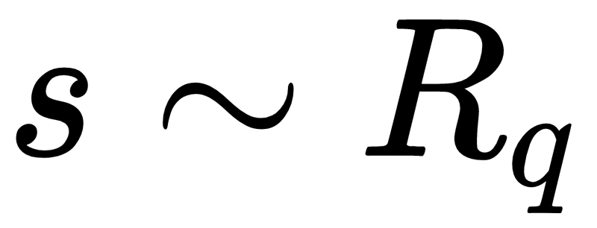
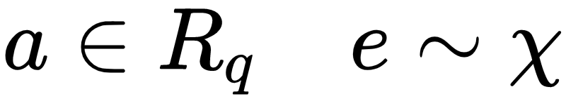

The underlying hard problem - RLWE
The security of HE :
Rings of the form :
Search problem : find s given random noisy inner products

Slide 8
Implementation Details

Slide 9
Client
Handles encryption and decryption - using Fan Vercauteren HE.
Builds context from encryption parameters.
Builds evaluator, denoise and relinearization objects using context.
Passes public objects to server, hides secret key.

Slide 10
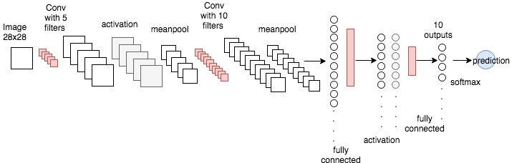
Server - Training Phase
Network

Slide 11
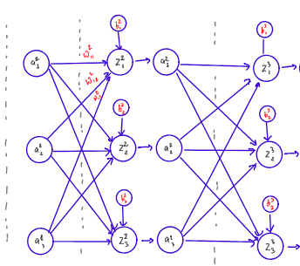
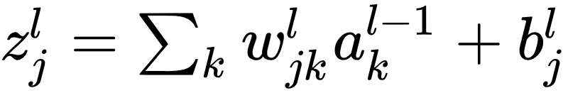
Server - Inference Phase
Network migrated to encrypted realm - Fully connected layers

Slide 12
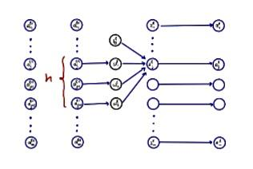
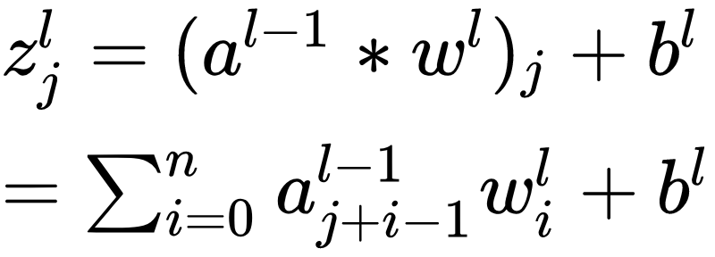
Server - Inference Phase
Network migrated to encrypted realm - convolution layers.

Slide 13
Challenges

Slide 14
Mismatch of atomic constructs
Neural network : Rational numbers
FV HE scheme : Polynomials in
Need to encode before encrypting and decode after decrypting

Slide 15
Controlling Noise and coefficient growth
Cipher texts contain a random component - for CPA security.
Cannot be recovered if noise spills over into message.
Limit the number of operations or increase the ciphertext coefficient modulus
Bootstrapping - decrypt a previous encryption inside a new encryption
Growing numbers during computation should not exceed the plaintext modulus

Slide 16
Efficiency
Increasing polynomial modulus increases the noise budget but also makes the polynomials larger and the algorithm less efficient.
Fresh encryptions - size 2. Input ciphertexts : size M and N, output ciphertext after multiplication will have size M+N-1
Relinearization - to compress the cipher texts to size 2 again.
Tension : Security level - Efficiency - Noise growth control.

Slide 17
Results

Slide 18


Slide 19
Different versions of network and different activation functions.
Highest accuracy obtained : 98.43%
Time taken by the network with minimum values of parameters for correctness and security ~ 900s

Slide 20
Thank you

